Slide 1

Worker
Misclassification

Slide 2
Agenda
Define “misclassification”
Impact of misclassification
Virginia laws regarding misclassification
Task Force

Slide 3
What is “Worker Misclassification?”
Treatment by an employing unit of a worker as an
independent contractor (or sub-contractor)
when the worker is in fact an employee.

Slide 4

Worker
Person who performs work in exchange for remuneration (pay)
Can be an employee or an independent contractor

Slide 5
Employing Unit (EU)
The business that assigns work to a worker in exchange for payment
Does not include a consumer

Slide 6

Employee
Subject to direction and control of EU
  EU determines when / where / how work is performed
  EU provides tools & materials
Is not working in capacity of a business owner/operator
Usually paid by time (hourly, weekly, or yearly salary)

Slide 7

Independent Contractor
Not subject to direction and control of EU (but EU may set quality standards and deadlines)
Owns/operates business
  Licensing
  Insurance
Usually paid a piece or job rate
Usually provides tools/materials
Should have a written contract

Slide 8
Employee or Independent Contractor?
Some statutory exclusions from employment:
  truck owner-operators and lessees
  some agricultural labor
  some domestic employment
  fishing & crabbing
  work performed for spouse, son/daughter, or parent (if worker<21)
  college students working for their school
  interns and student nurses
  commission-based insurance agents, realtors, and gasoline distributors (wholesale)

Slide 9
Employee or Independent Contractor?
Statutory exclusions from employment (cont’d):
  work/study programs at public or non-profit colleges
  human services contracted by a commonwealth, city or county human services agency
  sales personnel who are commissioned based and have a contract
  newspaper delivery personnel who are commissioned based and have a contract
  taxi and sedan drivers
  courier drivers

Slide 10
Employee or Independent Contractor?
Statutory exclusions from employment (cont’d):
  college students working at camps
  court reporters
  cosmetologists (including manicurists) and barbers
  psychiatrists, therapists, and LCSW’s working under contract
  prison work (by inmates)

Slide 11

Employee or Independent Contractor?
Aside from previous exceptions, legal presumption is “employee.”
Presumption is rebuttable
  Burden is on the employing unit.
  Standard of proof: preponderance

Slide 12

Employee or Independent Contractor?
VEC considers 20 factors (“IRS test”):
  Instructions (when, where, how)
  Training
  Integration
  Services rendered personally
  Hiring/supervising/paying assistants
  Continuing relationship
  Set hours of work
  Full time required
  Work done on premises
  Order/sequence set

Slide 13
Employee or Independent Contractor?
VEC considers 20 factors (“IRS test”) cont’d:
  Reports
  Payment by hour/week/month
  Payment of expenses
  Furnishing of tools/materials
  Significant investment in facilities
  Profit or loss
  Working for more than one business at a time
  Making services available to general public
  Right to fire
  Right to quit

Slide 14
Treatment of an Independent Contractor (IC)
Proper treatment of an independent contractor by an EU includes:
  Checking licensing before accepting/considering bid
  Soliciting IC’s TIN
  Not exerting more direction/control than is specified in the contract
  Making timely payments per schedule specified in contract
  Providing 1099(s) at end of job or end of year

Slide 15
Treatment of an Employee
Proper treatment of an employee by an EU includes:
  At commencement of employment:
    I-9
    W-4
    Court-ordered support
    Virginia New Hire
  Compliance with Virginia and U.S. minimum wage and overtime rules

Slide 16
Treatment of an Employee
Employee included with Worker’s Compensation policy (accurate description of number and types of employees provided to carrier)
Wages reported to VEC for unemployment insurance coverage
Payroll withholdings
  FICA (Social Security and Medicare)
  State income tax
  Federal income tax
W-2 in January

Slide 17
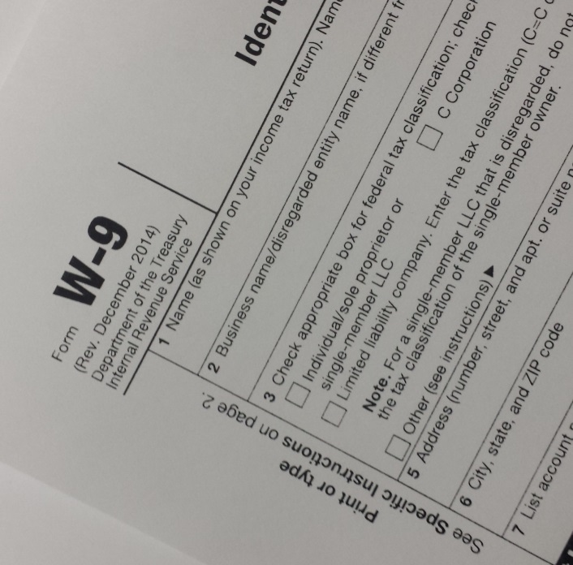
In Fact
What matters most is what is really happening
The existence of a W-9, a contract, and a 1099 are indicative but not dispositive.
An EU can’t “convert” an employee into an independent contractor by filling out some forms.

Slide 18
Why Does it Matter?
Misclassification harms:
  Workers
  Law-abiding businesses (competitors)
  Taxpayers

Slide 19
Applicable Virginia Laws
Virginia Unemployment Compensation Act (Title 60.2)
  EU shall report new hires and re-hires to the Virginia New Hire Reporting Center.
  EU shall request each new hire to disclose child support withholding orders.
  EU may not require/accept agreement to waive Unemployment Insurance benefits or rights.
  Violations are Class 1 Misdemeanors (up to 1 year in jail).

Slide 20
Applicable Virginia Laws
Fraud Against Taxpayers Act (Title 8.01, Art. 19.1)
  Presenting a false/fraudulent claim, knowingly making a false statement, or knowingly avoiding an obligation to the Commonwealth is subject to penalty of up to $11,000 plus treble damages.

Slide 21
Applicable Virginia Laws
Professions and Occupations (Title 54.1)
  Contracting or bidding without a license is a Class 1 Misdemeanor.
  Receiving/considering a bid without first receiving the bidder’s license is a Class 1 Misdemeanor.
  Worker who undertakes work without proper license/certificate commits a Class 1 Misdemeanor and is subject to fine of $500/day.

Slide 22
Applicable Virginia Laws
Tax (Title 58.1)
  EU who fails to withhold/submit required withholdings is subject to civil penalty of 6% per month plus interest.
  Willful failure is a Class 1 Misdemeanor.
DOLI (VOSH)
  An EU with misclassified workers is not entitled to size / good faith reductions when calculating penalties for safety violations.

Slide 23
Sources of Compliance Reviews
Complaints
  Workers
  Competitors
Referrals from other government agencies
Random selections
1099 extract information (coming soon)

Slide 24
Inter-Agency Task Force on Worker Misclassification and Payroll Fraud
Established in 2014
Members:
  Secretary of Commerce and Trade (Chair)
  Virginia Employment Commission
  Department of Labor and Industry
  Worker’s Compensation Commission
  State Corporations Commission
  Department of Professional and Occupational Licensing
  Department of Taxation
  Office of the Attorney General

Slide 25
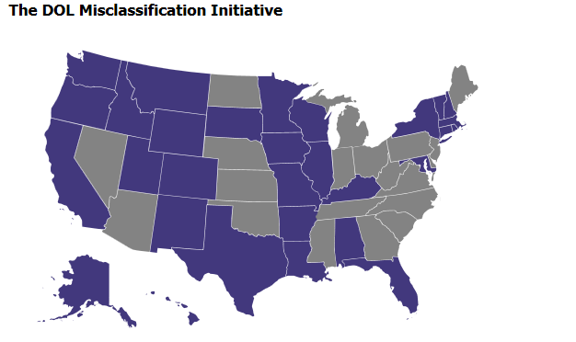
Partnership with U.S. Department of Labor
As of June 16, 2016, Virginia should be shaded blue, having become the 31st state to enter a MOU with USDOL
Information sharing
Resource sharing
Hot button issue for USDOL Sec. Tom Perez
Source: https://www.dol.gov/whd/workers/misclassification/

Slide 26
Questions? Comments?
Complaints / Referrals?
Contact: Virginia Employment Commission
Targeted Audit and Investigative Enforcement Unit
(804) 371-4218
geoff.garner@vec.virginia.gov

