Slide 1
Work Opportunity Tax Credit
(WOTC)
Presented by Priscilla Skinner
WOTC State Coordinator
June 15, 2023

Slide 2
What is WOTC?
Federal tax credit available to for-profit employers that invest in the hiring of American job seekers who have consistently faced barriers to employment.
Non-profit employers can participate. Non-profit employer participation is limited to the veteran target group and the tax credit is applied to a portion of their share of social security liability.
WOTC has been authorized by the federal government through December 31, 2025.

Slide 3
Target Groups
for WOTC
Maximum Tax Credit
Supplemental Nutritional Assistance (SNAP) Recipient $2,400
Temporary Assistance for Needy Families (TANF) Recipient $2,400
Long Term Assistance for Needy Families (LTFAR) *$9,000
Ex-Felon ( Including Work Release Program participants) $2,400
Veterans (including service-connected disabled) $2,400 - $9,600
Social Security Income (SSI) Recipients $2,400
Vocational Rehabilitation Referral $2,400
Designated Community Resident (includes Empowerment Zones) $2,400
DCR includes Buchanan, Dickenson, Highland and Lee as well as
the cities of Clifton Forge, Covington, Norton and Staunton.
Virginia EZ includes specific areas within Portsmouth and Norfolk.
Ticket-to-Work Holder $2,400
Long Term Unemployment Recipient $2,400
Summer Youth Employee $1,200
*Tax Credit is taken over 2 years

Slide 4

Who is Eligible?
Job seekers that have never worked for the employer (new hires).
Current or former employees are not eligible regardless of when the employee last worked for the employer.
Family members of employer are not eligible.

Slide 5
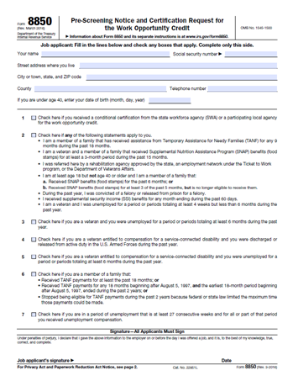
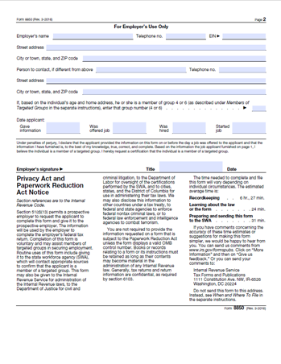
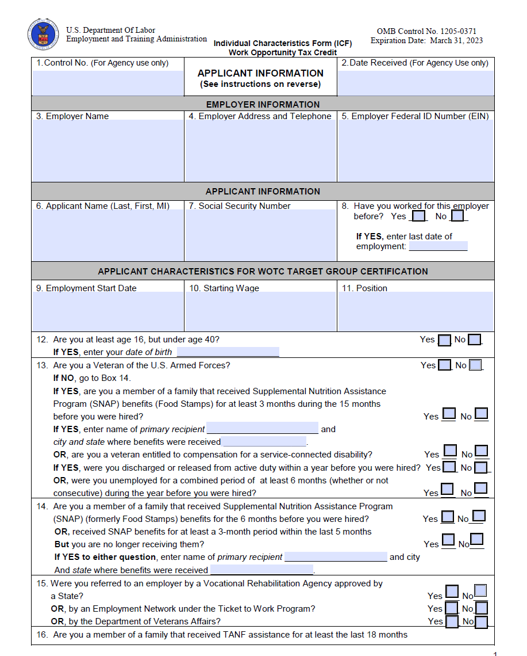
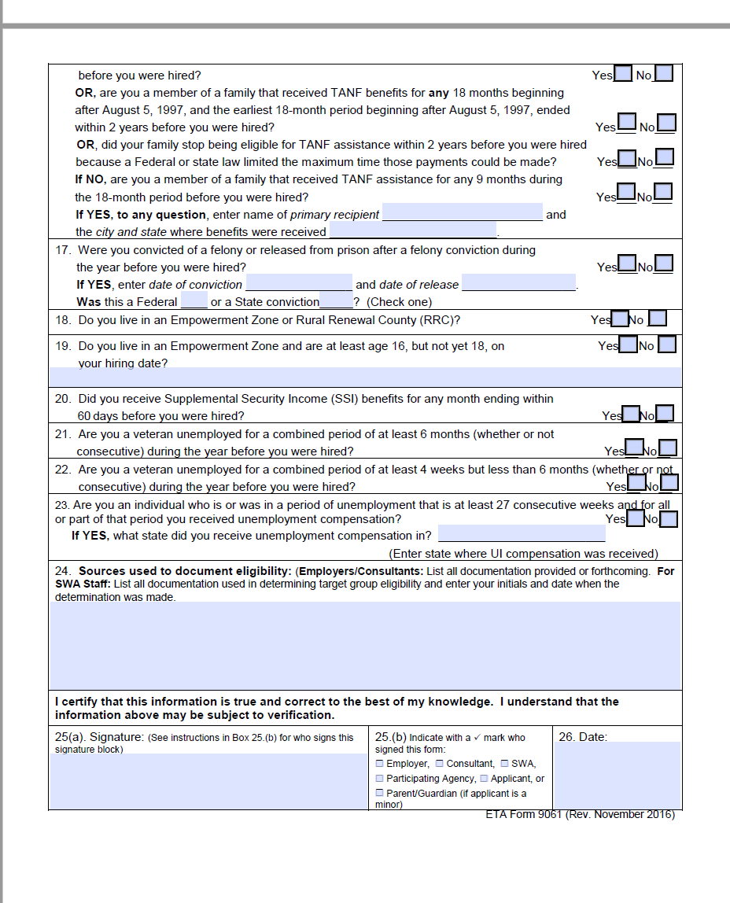
How to Apply?
Form 8850
Form 9061
Visit the Department of Labor website https://www.dol.gov/agencies/eta/wotc to obtain WOTC forms and additional information about the WOTC program

Slide 6
How to Apply?
Employer checks online system for application status (New, Certification, Denied, OOS, SSI/TTW, Verify, etc.).
Employer must retain certified applicants for a minimum of 120 hours to take the minimum tax credit or 400 hours to take the maximum tax credit.
File Form 5884 or 5884C with federal tax forms.

Slide 7
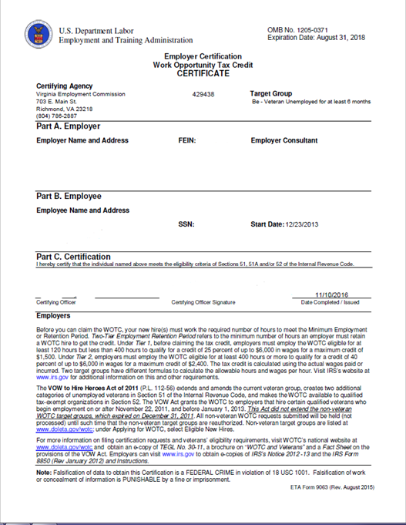
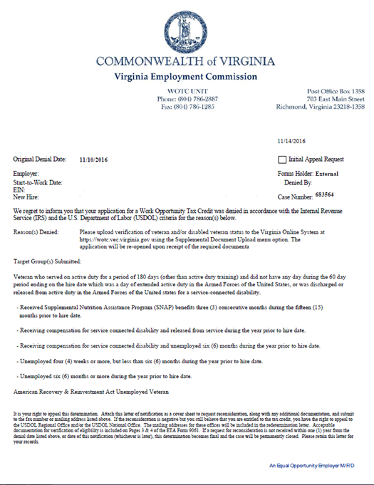
How to Apply?
Important Note:
A denial may be a request for additional information.

Slide 8

2022 WOTC Statistics
WOTC Submission Requests 149,206
Certifications 65,069
Denials 94,570
Potential Maximum Tax Credit Amounts $191,058,600

Slide 9
Thank You!
Priscilla Skinner
(804) 786-4341
priscilla.skinner@vec.virginia.gov

